Slide 1
Session 2
Homework Observations---
Be sure to turn in the Homework. Accelerator assignments need to be put into the PRIMMS document repository. I grade and comment on the documents and upload back into the repository.
No need to add events to PRIMMS. We will cover everything that you need to know about the tool.
PRIMMS questions on discussion board regarding the project structure.
Project Management complements data science by improving efficiency of project execution.

Slide 2
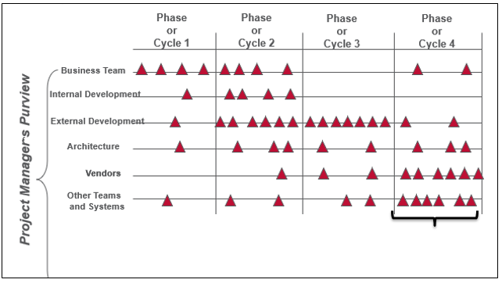
Events in a Waterfall or Agile Project Life Cycle
Events
Key Deliverables
Work Streams
Quality and Completion Criteria
2

Slide 3
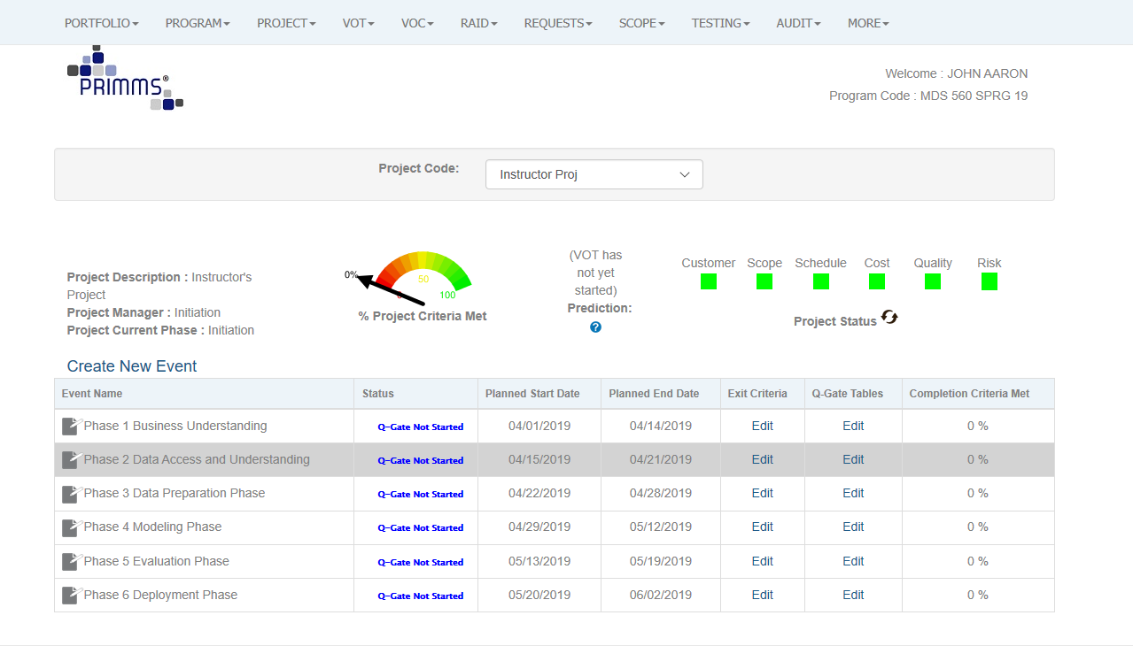
We Build and Track Our Plan
We Will Touch on Phases 1-4 Today

Slide 4
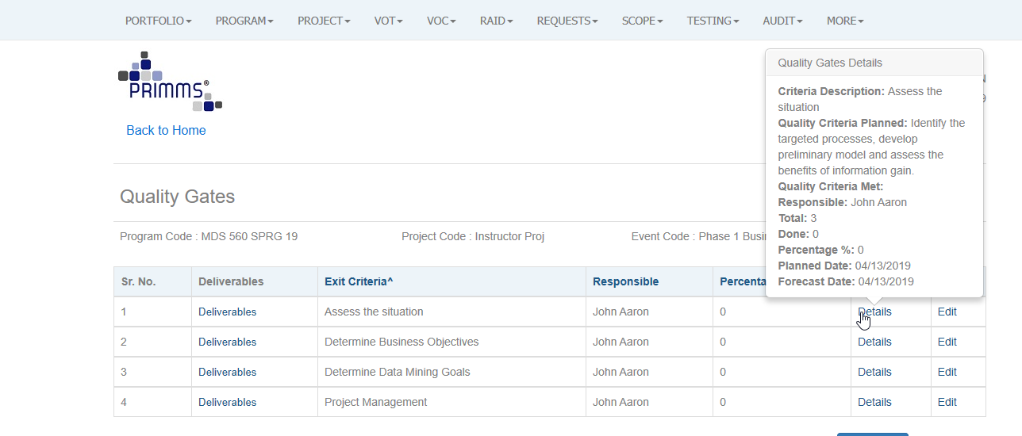

Slide 5
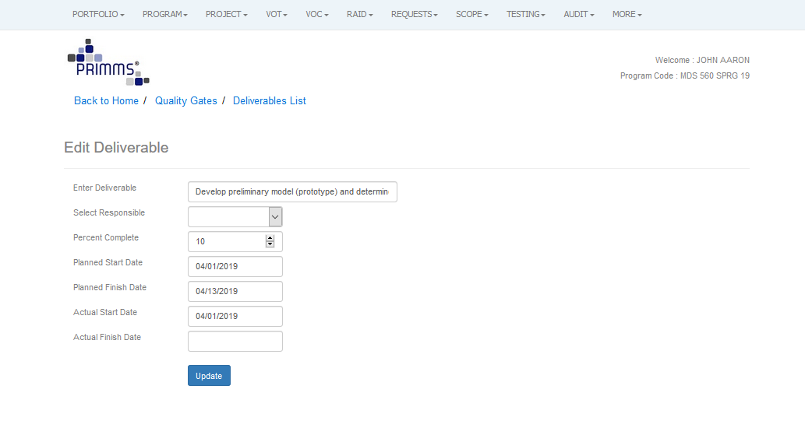

Slide 6
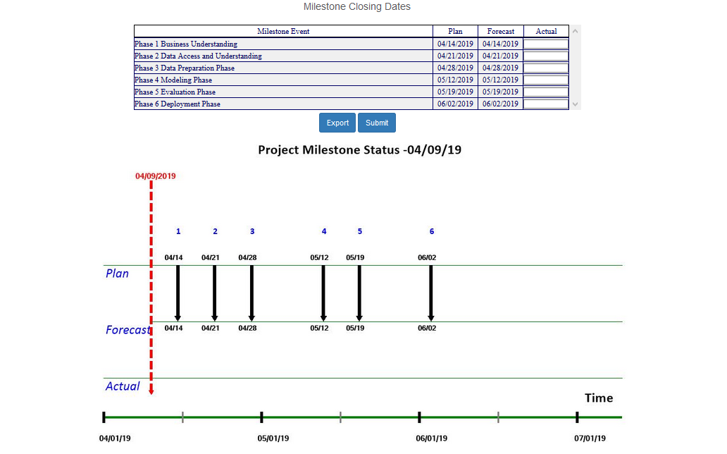

Slide 7
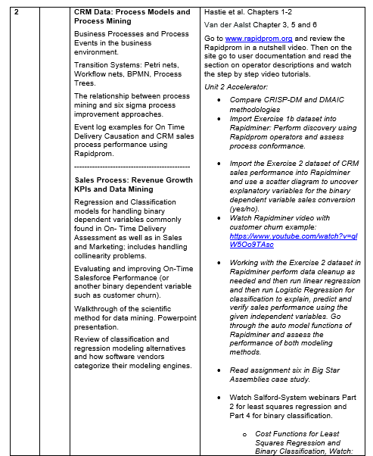

Week 2 Assignment

Slide 8
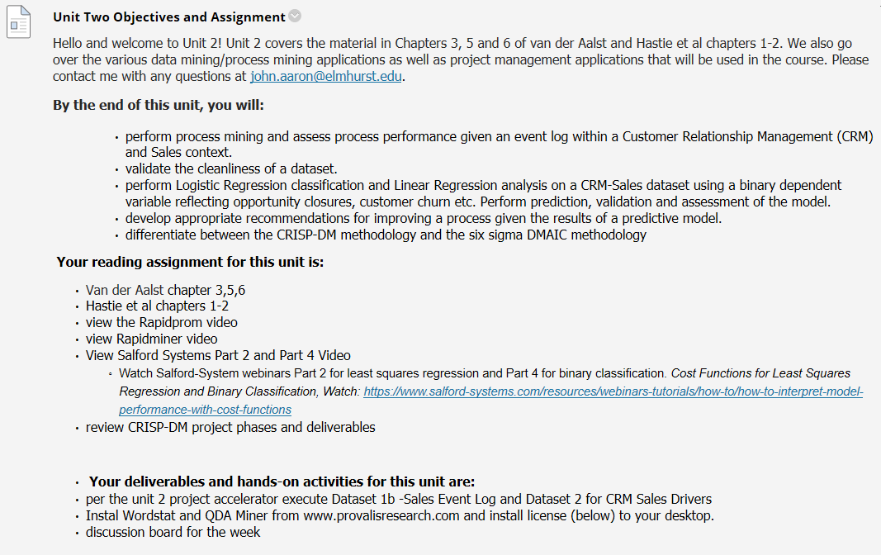

Slide 9
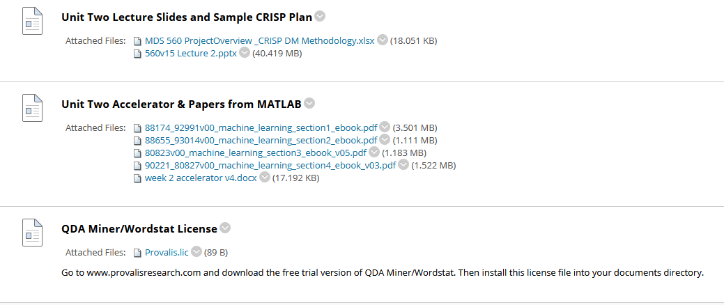
Instructor Lecture Examples
BB Unit 2
Written Homework for the Week

Slide 10
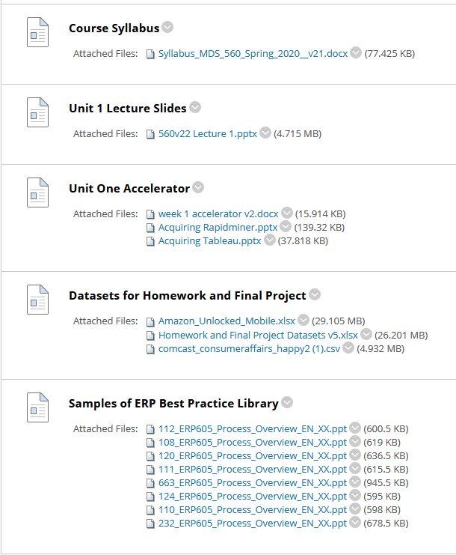
BB Unit 1
Keep these handy each week

Slide 11
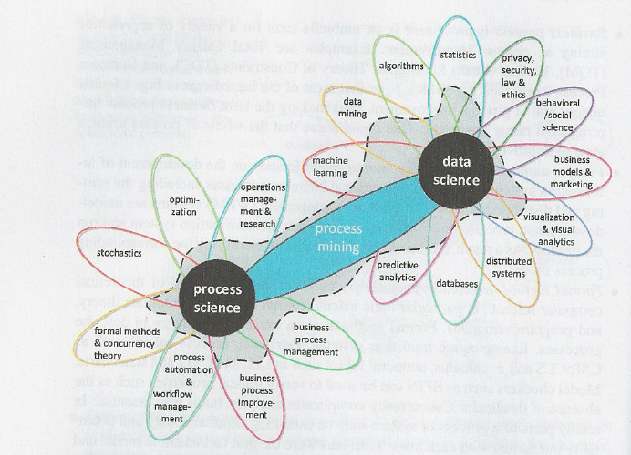

Data Science and Process Science Are a Powerful Combination Leading to Enterprise Value Creation
“The goal of process mining is to turn event data into insights and actions.”
DMAIC
Six Sigma
CRISP-DM

Slide 12
The SIPOC Framework Remains Key
Your Company
Sales & Market
HCM
Delivery/ Returns
Supplier’s Supplier
Make/Ops
Customer
Customer’s
Customer
Supplier
Source
Finance
IT
Common KPI’s
Loyalty
Growth
Quality
Delivery
Inventory
Productivity
$
This is a variation of the APICS SCOR framework.

Slide 13
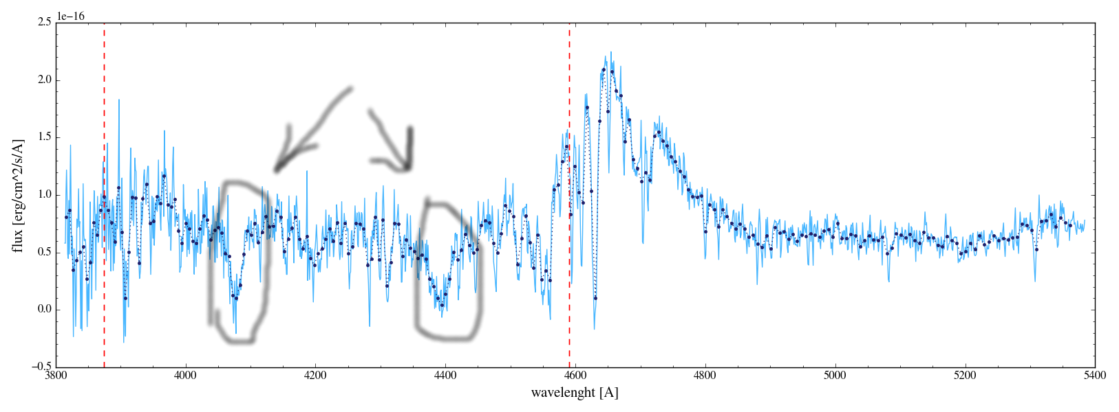
Process
Input
Output
Supplier
Customer
Is the Process Highly Visible?
Do You Have a Target KPI History?
Do You Have Historical Explanatory Data? (Transactions, Interactions, Events, Machine )
Can Explanation and Prediction Be Leveraged to Improve Process Quality and Productivity?
Process Performance Indicator

Slide 14
Process
Input
Output
Supplier
Customer
Is the Process Highly Visible?
Do You Have a Target KPI History?
Do You Have Historical Explanatory Data? (Transactions, Interactions, Events, Machine )
Can Explanation and Prediction Be Leveraged to Improve Process Quality and Productivity?
Process Performance Indicator

Slide 15
From a Process Quality Perspective Can AI and Big Data Become the Tools To Predict and Preempt Problems And Drive Automation?
Feedback and Feedforward Controller
Reinforcement Learning
Process
Closed Loop Not In Our Scope
Our Focus is Business Process, Not Devices
Automated
Actions
Input
Output
Supplier
Preventative
Actions
Customer
Process
X Data
Decisions
Predictions Y’
Y
Y=f(X)
Machine Learning
KPI: Process Performance Indicator

Slide 16
In Class Example Sample Situation
You have taken on a new assignment, and you are the lead data scientist for Big Star Assemblies. The COO wants you to work with the operations and marketing teams to solve a difficult on time delivery problem for the company. Market research studies indicate that customers are generally dissatisfied with Big Star’s on time delivery performance. Currently, the company quotes 30 day lead times for all customers, for all orders. Big Star is meeting delivery commitments to customers only about 45% of the time!
As you join the team, you notice that they are attempting to follow a Six sigma DMAIC methodology. They have created a project charter and have built out a project plan. However, they are struggling to define and measure the process. Your strategy is two fold. First you decide to use Event Logs available from their CRM and ERP system to help define and measure the process.
As a second step you follow the CRISP-DM project methodology to help the team measure the process in more detail and to Analyze and Improve the process.
You pull a sample of 33 orders taken on Jan 1st 2016 and construct an event log that will enable you to perform process mining.
What is the insight obtained?
What is the implication for action?

Slide 17
The Digitalization of the Customer Journey Allows for Many Touchpoints Using Different Media
Project Performance Reporting:
Cost
Scope
Schedule
Quality
Resources
Risk
IT Performance Reporting:
Cost
Outages
System Performance
Incidents
Security
Audits
Projects
Operations Projects
IT Infrastructure & Networks
-Replacement
-Process Improvement
Operations Performance Reporting

Slide 18
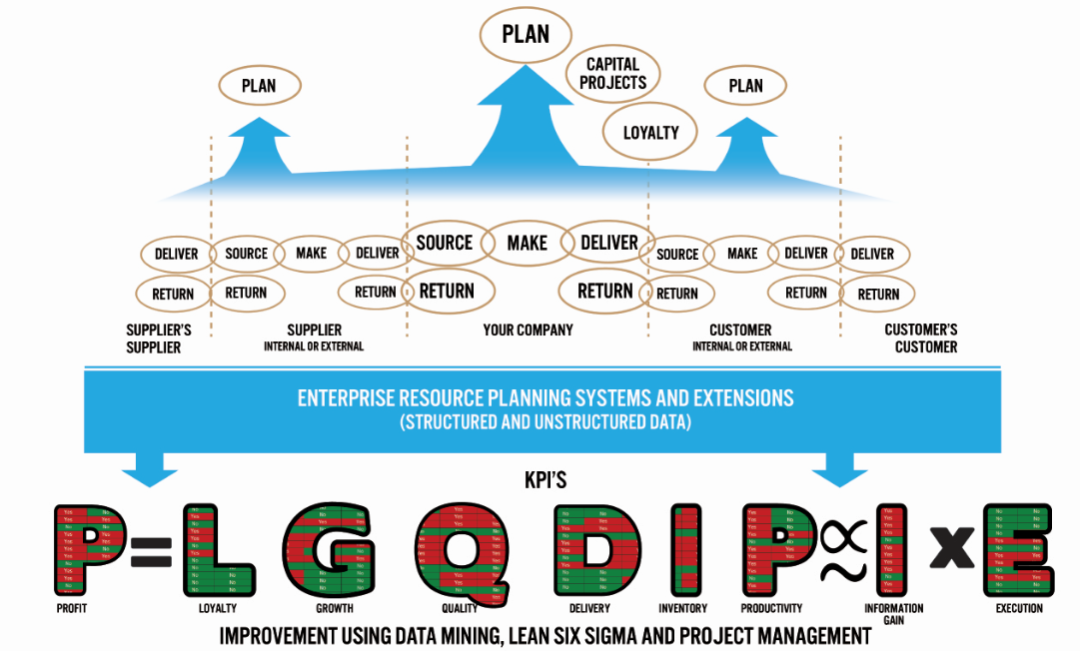
Adding the APICS
SCOR Dimension
Big Data
Target Variables

Slide 19
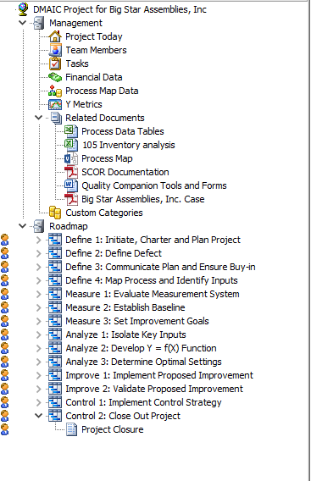
Six Sigma Projects Can Take A Very Long Time To Show Results
Tend to Focus on Customer Satisfaction By Resolving Quality Problems
Tend to Not Be Forward Looking For Value Opportunities Based Upon Growth
Tend to Ignore Discovery
This is changing!

Slide 20
Lean Six Sigma Brings an Action and Business Value Orientation
Examples
Align project with business goals and the VOC, and establish accurate metric baselines.
Ensure buy-in from process owner, finance and other stakeholders.
Communicate the project to stakeholders.
Ensure measurement system accuracy, collect data on inputs and outputs and prove the causal effect Y=f(X) using Lean Six Sigma tools and methods.
Improve measurement systems and refine analyses as needed to identify root causes and their solutions, that is, improvements or counter measures.
Select best alternative solution. Develop a detailed improvement plan and conduct a pilot study to prove that Y=f(X).
Integrate solutions into larger process based upon pilot study.
Create standardized procedures, processes and mistake-proofing.
Implement training and audits to sustain the solutions.
Create the control plan, apply control strategies, and transfer project ownership to the process owner and local work team.

Slide 21

Peirce’s Trichotomy of the Scientific Method
As Self-Correcting Cycles Leading to the “Truth”
Multiple
Hypotheses
Abductive
Reasoning
Begin Next Cycle with Convergence on “Truth”
What are Testable Conclusions About Other Phenomenon That Must Be Reached For Each Hypothesis if True?
Controlled Experiments Based Upon Samples From a Population
Explanatory
Hypotheses
Experience
Process Definition With “Counts”
What Must
Happen If True?
Deductive
Reasoning
Begin Research
Assess Results of Application and Adjust Hypotheses
A Question
Sufficient Accuracy Reached to Take Action
Elimination
of False Hypotheses
(retroduction)
Test Predictive
Models
Execute Actions
Inductive
Reasoning
Assess Accuracy
reflects imaginative interpretation of results.
Economics Plays a Role in Sufficiency Decision.
P(H|E) P(E|H) P(H) If You Don’t Follow, You Are Exposed to Losing Out To a Competitor!

Slide 22
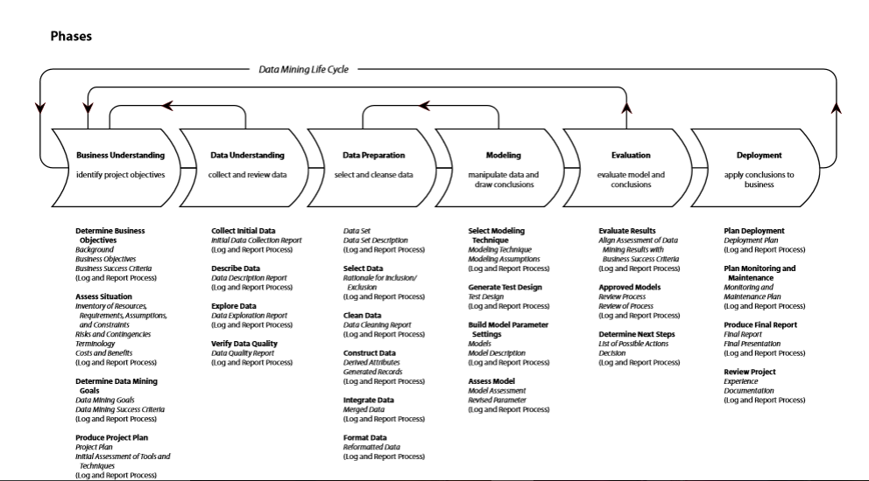
The CRISP-DM Project Methodology

Slide 23
The CRISP Life Cycle Is Actually Two Life Cycles
Objectives
Production
Data and Process Mining
Unit Test and UAT
Data Discovery and Algorithm Development
Machine Learning
Solution Deployment
Device
Tested
Code (Typically C, C+)

Slide 24
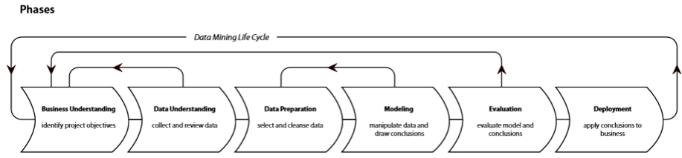
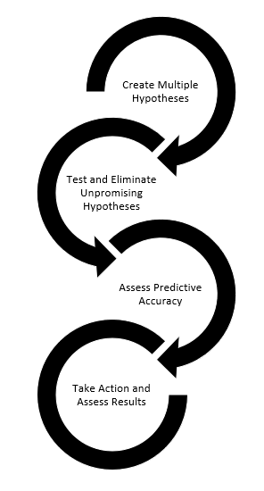
Progressive Elaboration Using CRISP Project Life Cycle
Deployed to Production
Prototype
Excel
Workbook
Server, Mobile Device, etc.

Slide 25
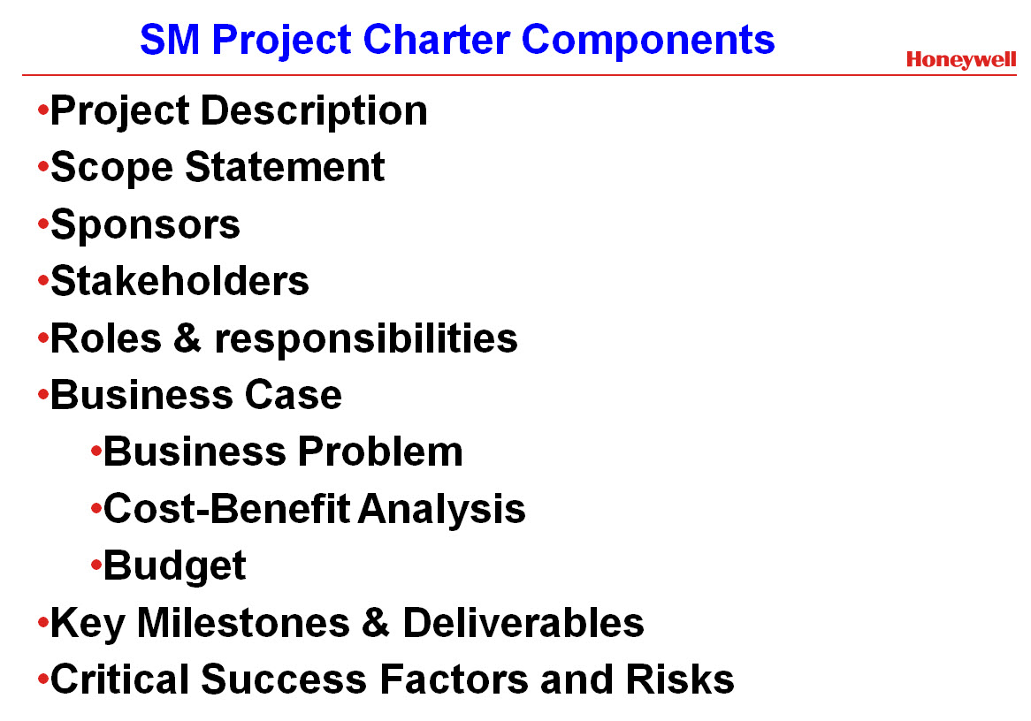
Project Charter Components
Problem statement

Slide 26

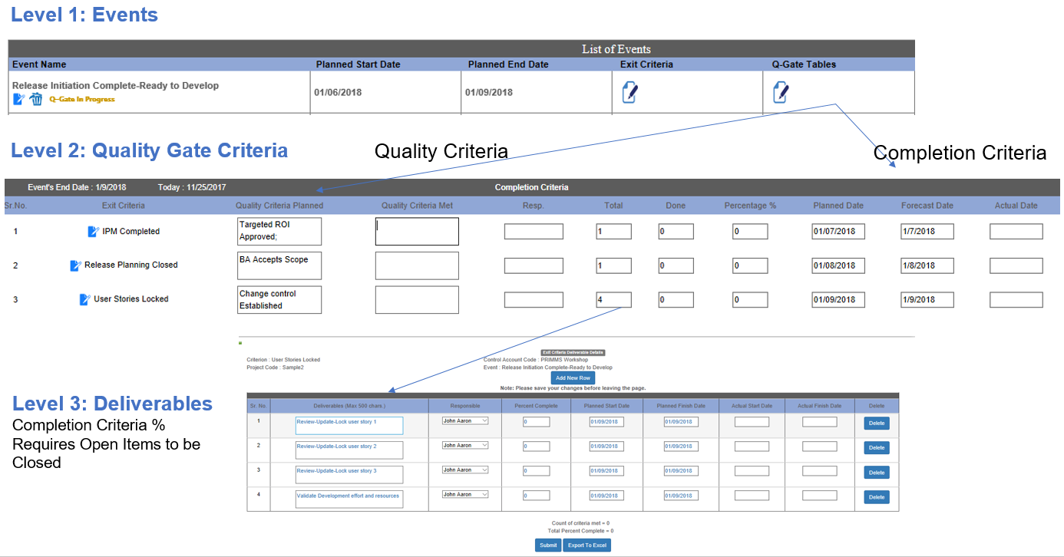
PRIMMS Three Level WBS
Hint: There is an option upload the WBS structure via Excel.
26

Slide 27
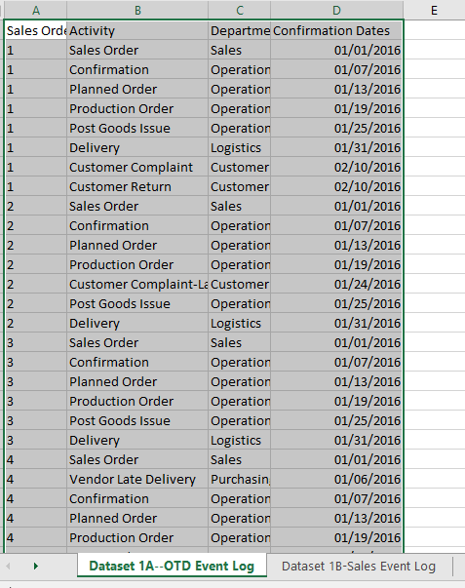
Event Log Data that we will use for this example 1A—OTD Event Log
Process Discovery Is Often a Necessary Early Analytical Step
Our text indicates that events may be:
Life events
Machine events
Organization events
IOE refers to all event data available including organizational transactions, interactions (communications) between individuals, confirmation of material movements, etc.
“Spreadsheets are not well suited for handling event data.
--Identifying bottlenecks
--Identifying deviations”

Slide 28
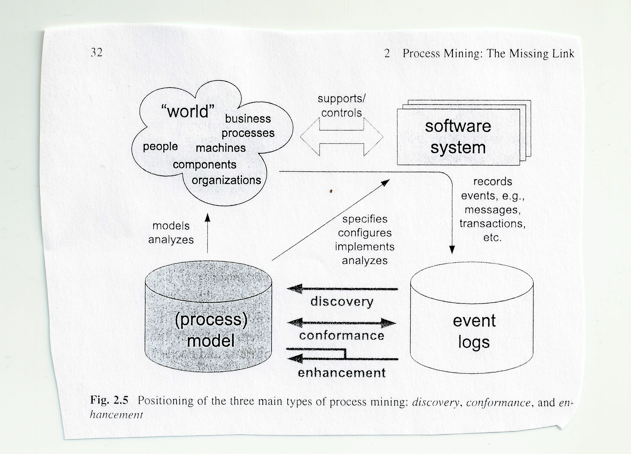
“Process mining is the missing link between data science and process science.”

Slide 29
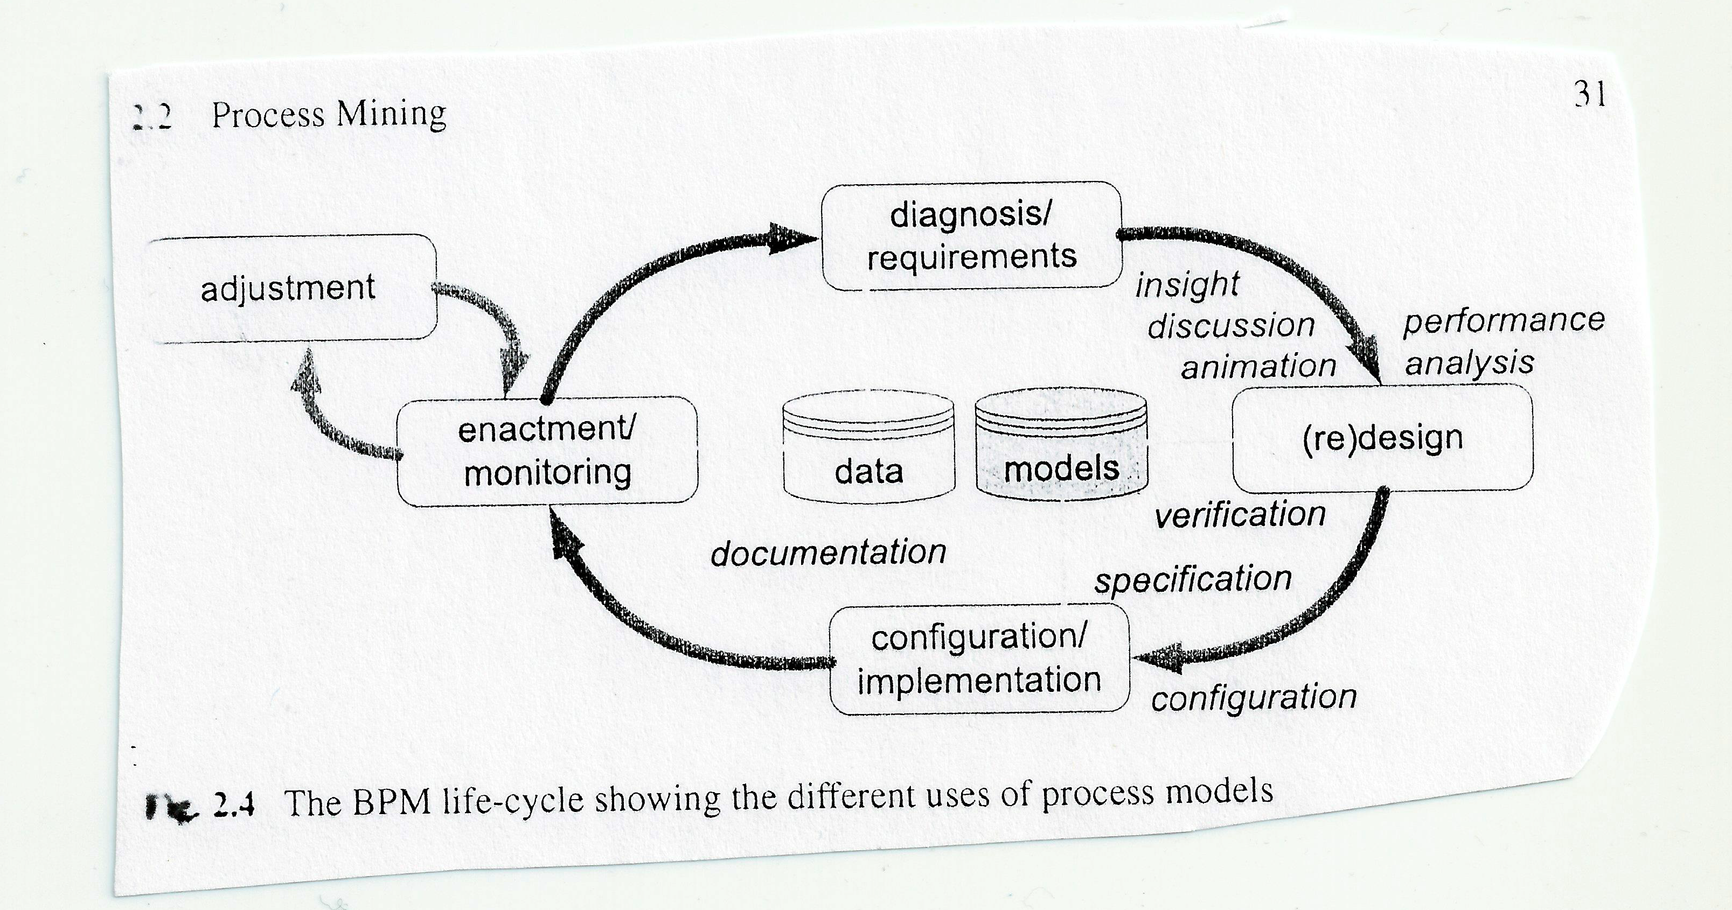

Slide 30
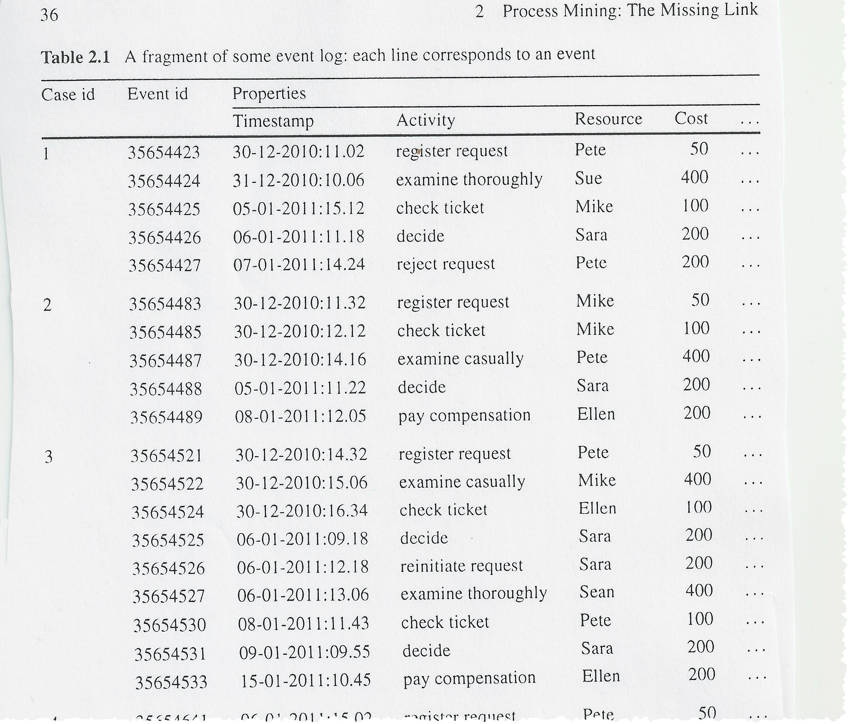
Event Logs shown in text
Can we identify the underlying process given knowledge of events?
Given our understanding of the process we can add timestamps to discover issues related to bottlenecks, service levels, throughput times, frequencies etc.

Slide 31
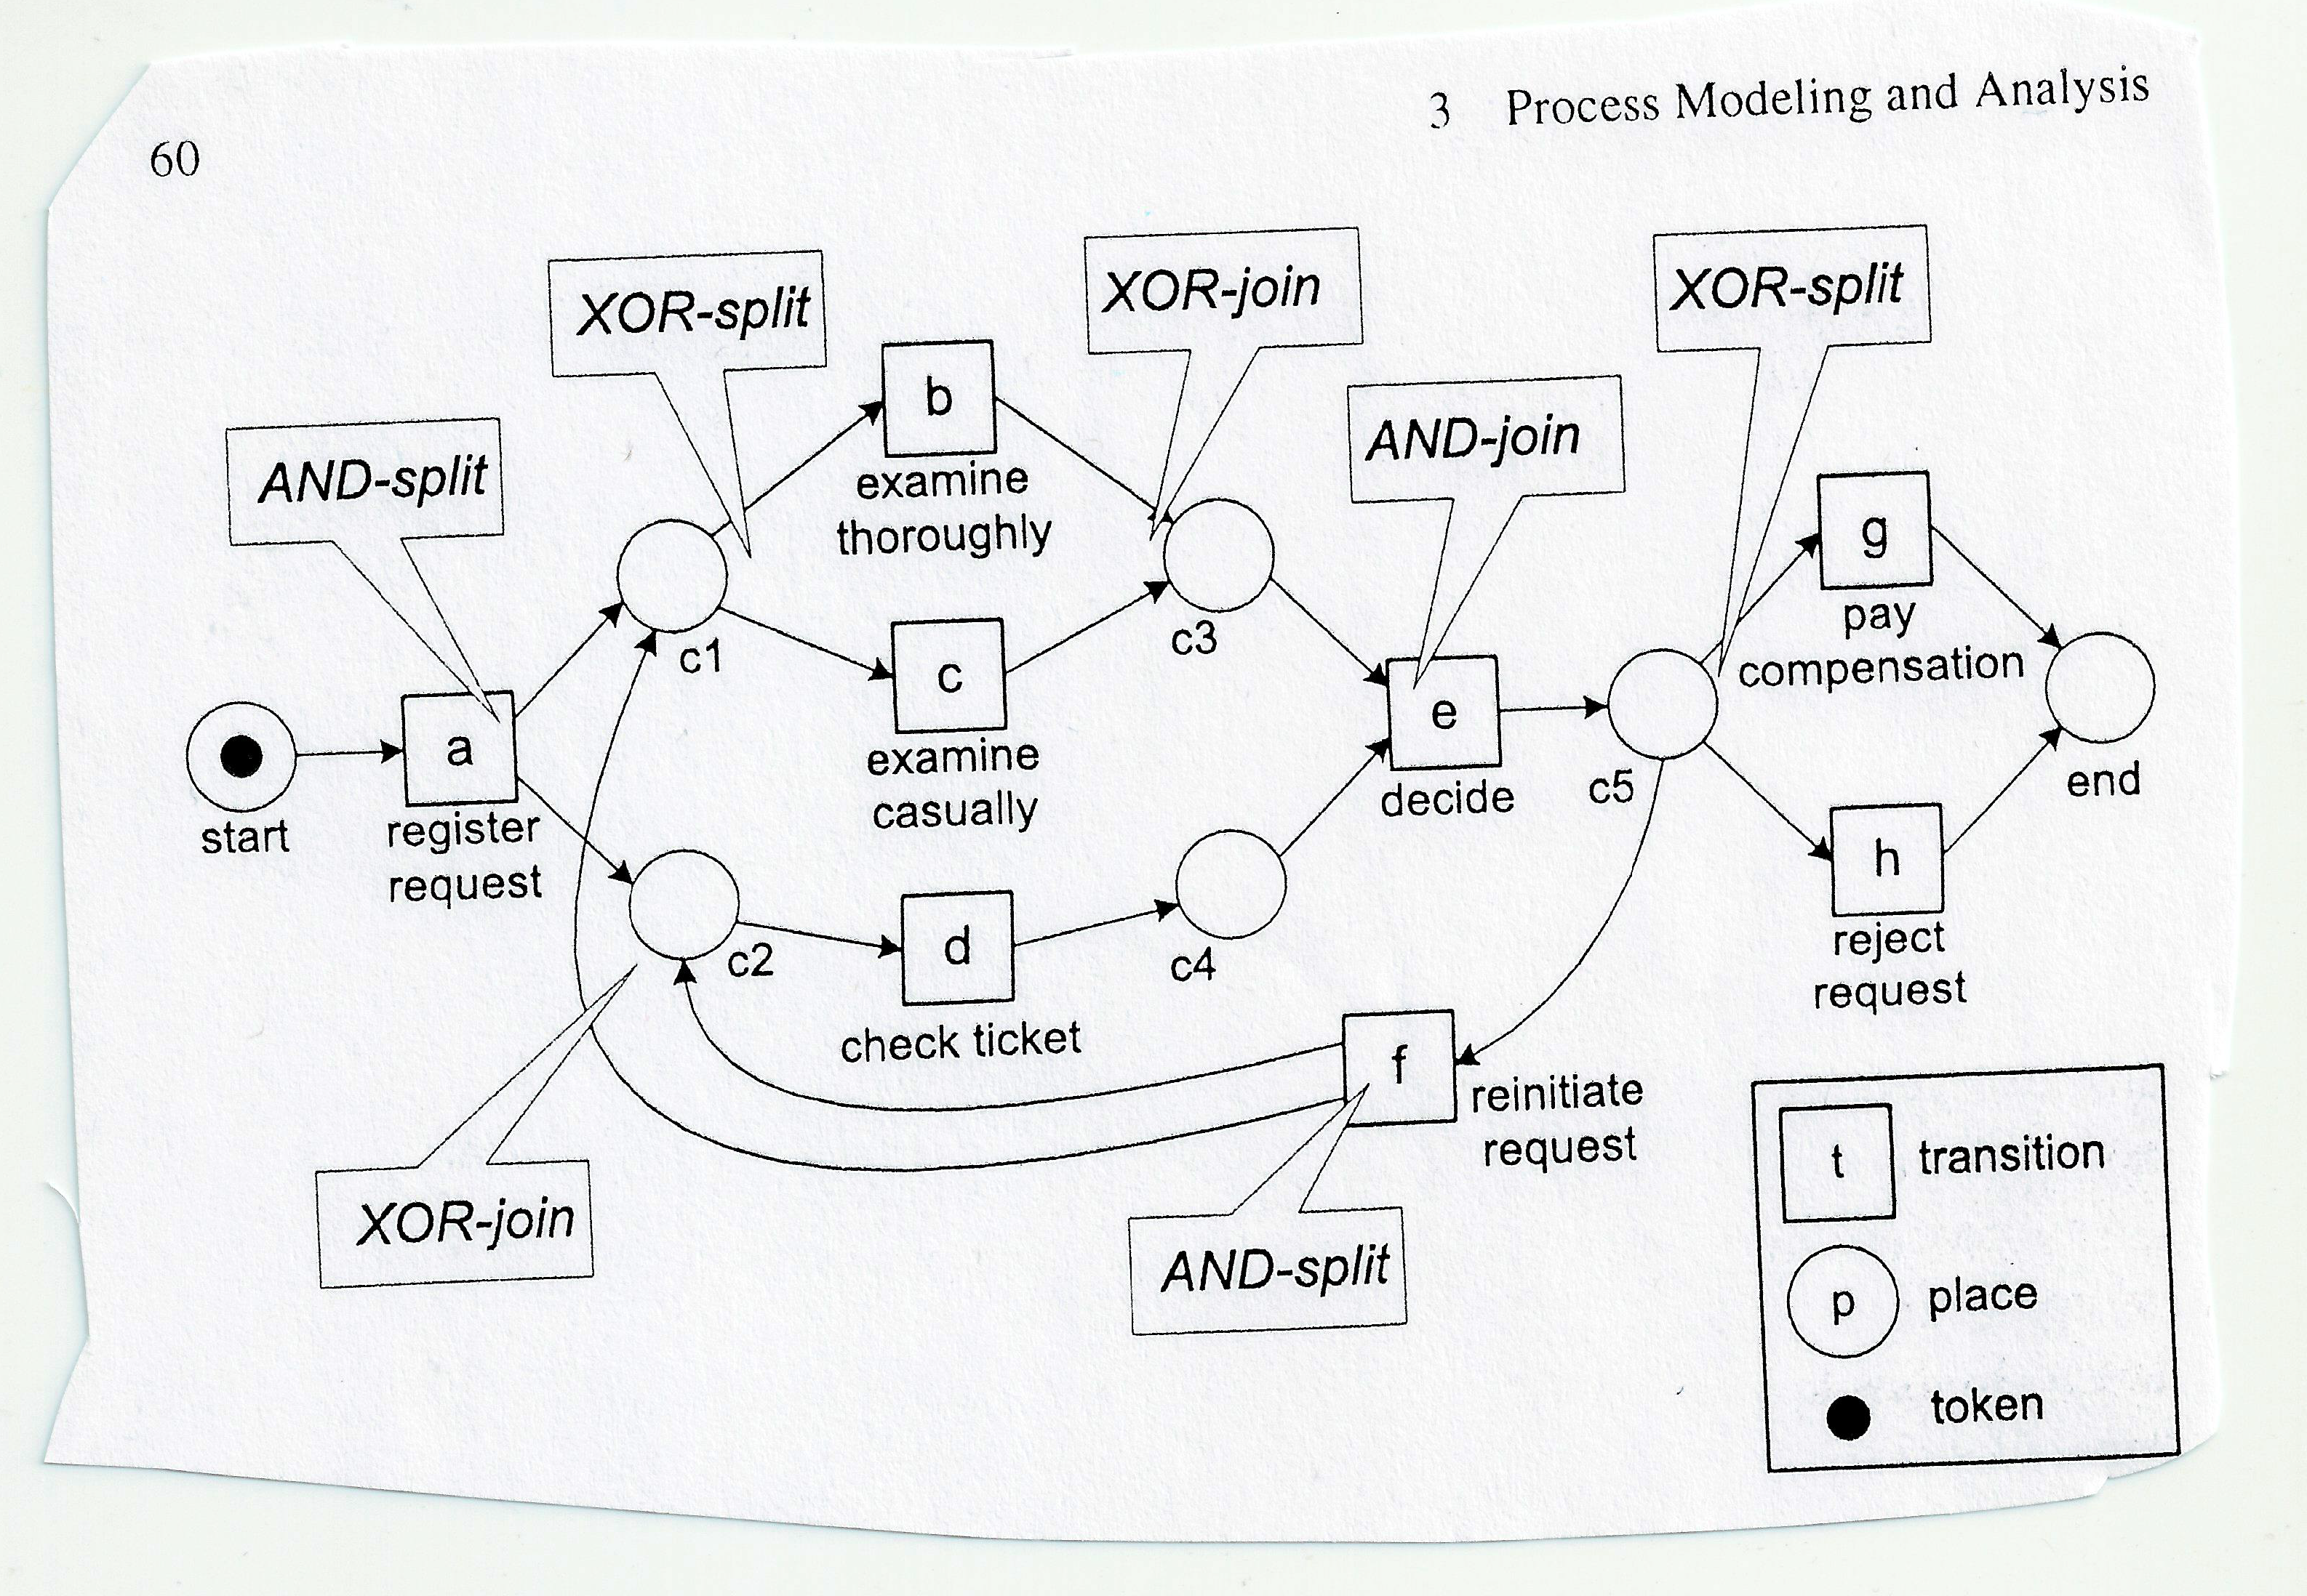
Token Transitions always leave a “trace” that can be recorded in a database.

Slide 32
Example
On Time Delivery
Sales
Make
Deliver
Return
Source
Time

Slide 33
Dataset 1A-OTD Event Log
We will use RapidProm to provide insights surrounding the discovery of a current state order fulfillment and delivery process.

Slide 34
Process Mining Helps Process Discovery and Leverages Event “Counting’
In data science we leverage event “counts”. Rapidprom is a sophisticated event counter.
Event counts are directly translatable to frequencies and therefore to event probabilities.
The principle of “Insufficient reason” suggests that absent information, all courses of action are equally probable. Event counts provide us with the necessary information gain to make decisions.
This opens the door for machine learning classification on business processes.

Slide 35
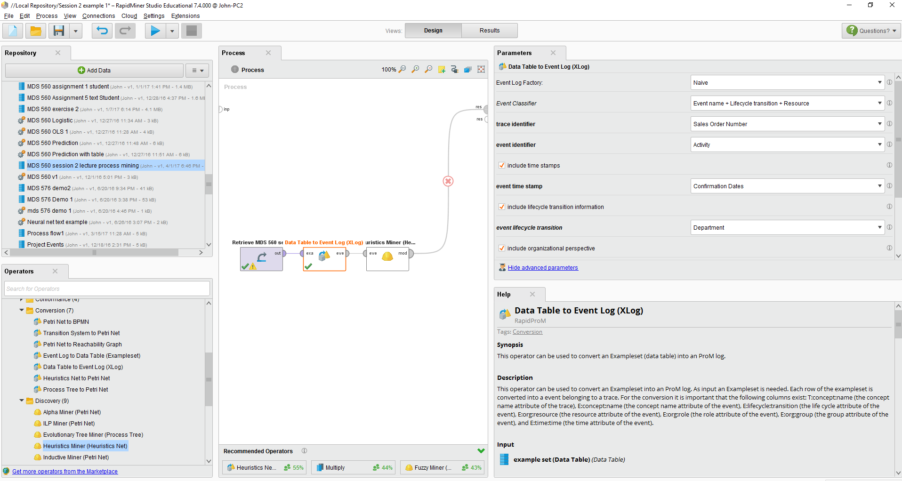

Slide 36
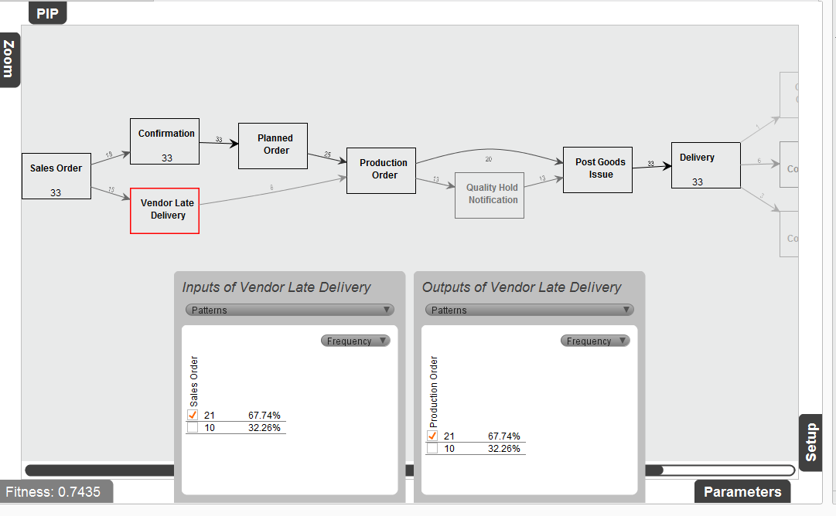
Heuristics Miner Shows the Value Stream
Direct Linkages (Directly Follows)
Non Value
Steps
21 orders experienced vendor late delivery
33 Sales Orders
Better than pivot tables
Replay Accuracy

Slide 37
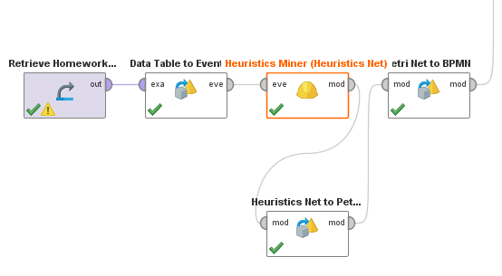
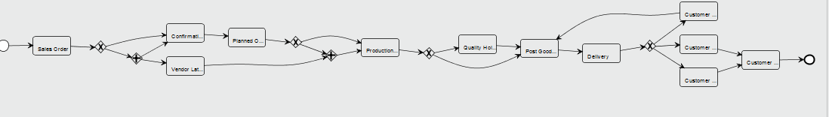

Slide 38
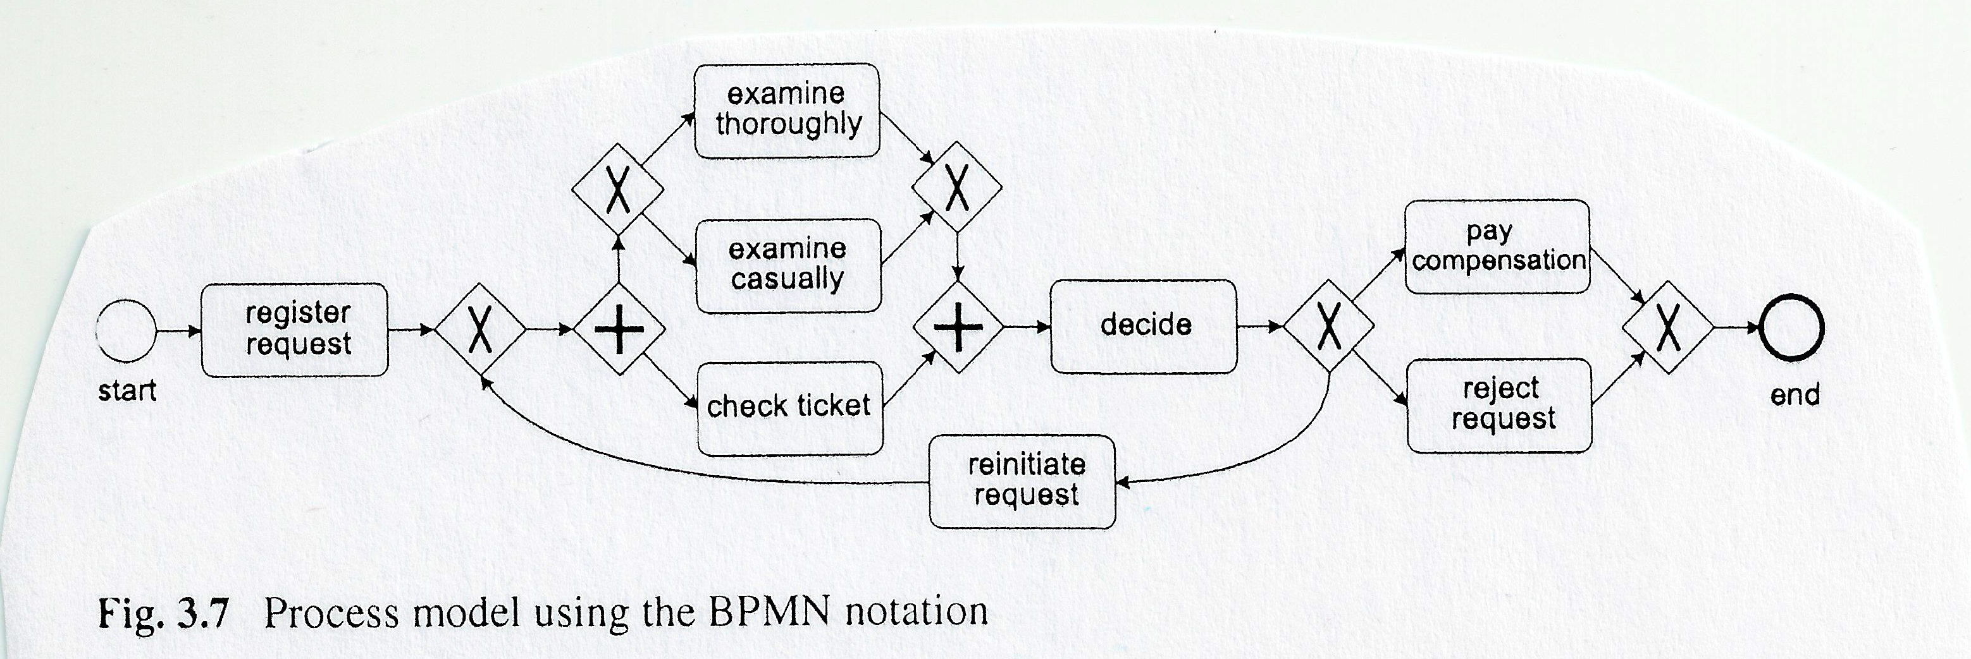
Note the Boolean logic operators

Slide 39
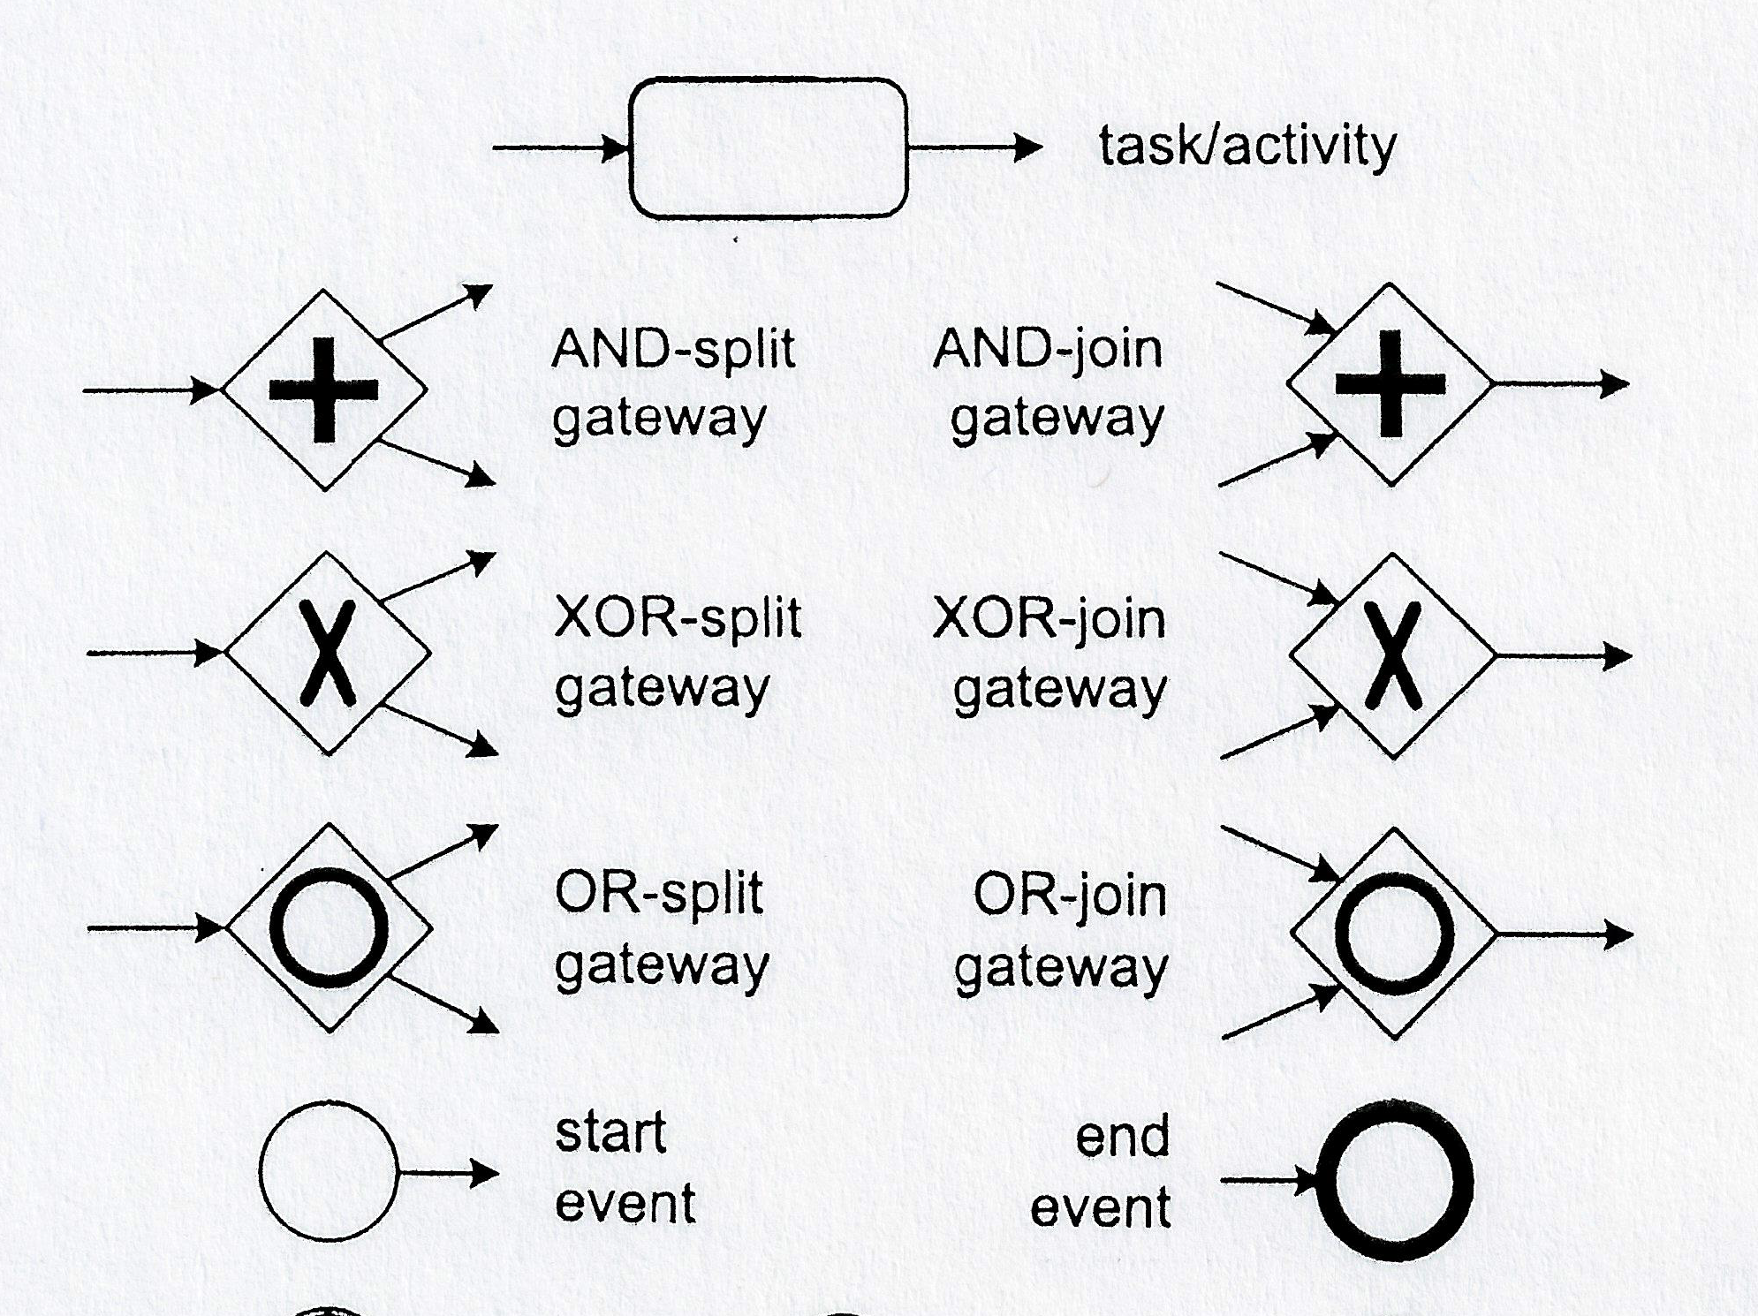

Slide 40
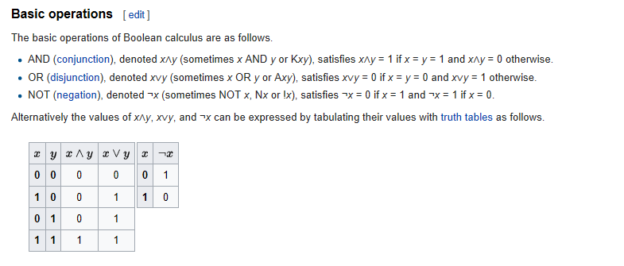
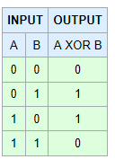
Exclusive OR

Slide 41
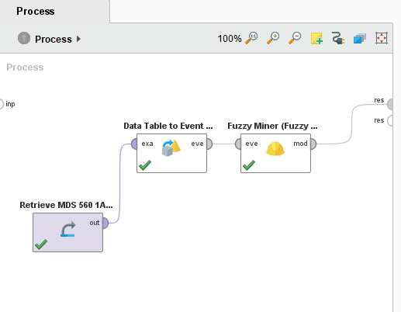
Fuzzy Miner Contains Some Interesting Conformance Checks To Help Assess Repeatability

Slide 42
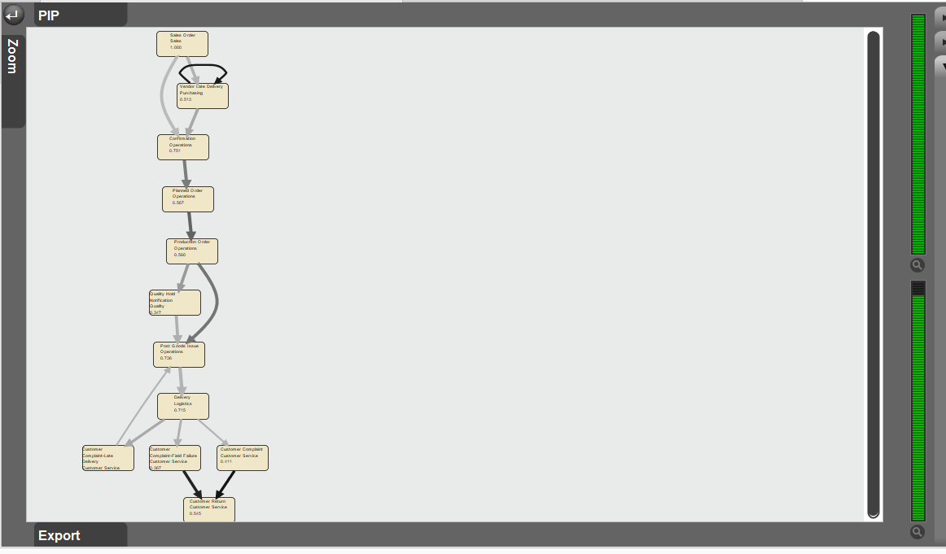
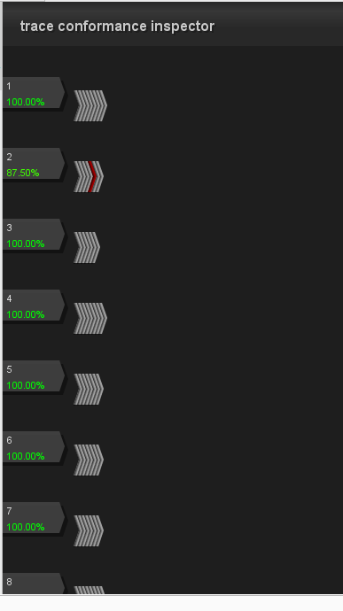
Click Here
Customer Complaint for Sales Order #2—Late Delivery

Slide 43
We Have Produced a Deliverable (A Validated Workflow that Everyone Agrees Has Enabled the Project to Move Forward

Slide 44
Your Homework Assignment Dataset 1b Sales Force Productivity Example Using CRM Data
(This is Dataset 1B-Sales Event Log)
Next, the National Sales manager is questioning the effectiveness of the salesforce. The manager asks the data scientist to mine the CRM contact database to determine important insights.
You (the data scientist) is able to look at the database and construct an event log (see next slide) for sales activities between 2010 and 2016.
Your assignment is to go into RapidProm and perform a transactional analysis as appropriate.
What is the insight obtained?
What is the implication for action?
Specifically
What is the Sales Process?
What are the most important activities affecting project success?
How well is the process meeting its objectives?
How well are the people performing?
What are the apparent root causes of performance problems?
Note: The apparent root causes become hypotheses (i.e. abductive reasoning) for later analysis.

Slide 45
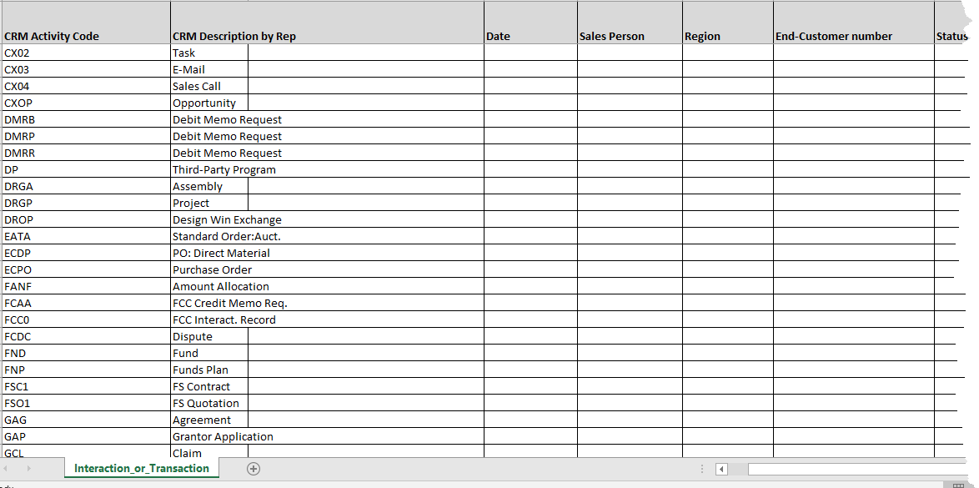
How Do We Define and Measure the Process Accurately and Efficiently?
Event Logs
Event Codes
Other Event Info

Slide 46
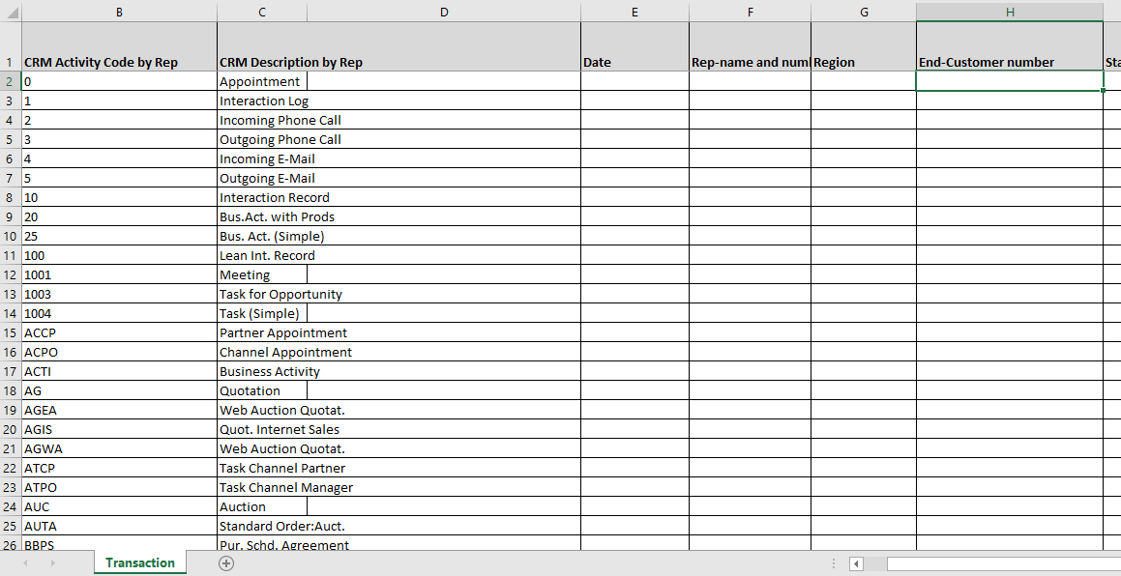
Example of CRM Transaction Codes Illustrates the Time Saving Value of Process Mining from Event Logs

Slide 47
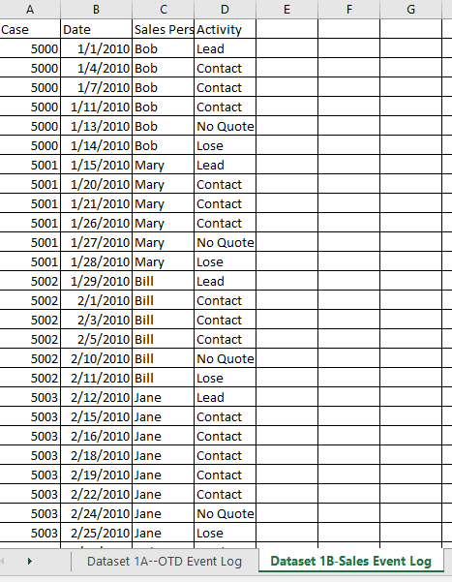
Partial View of a CRM Event Log for Homework Assignment 1B.

Slide 48
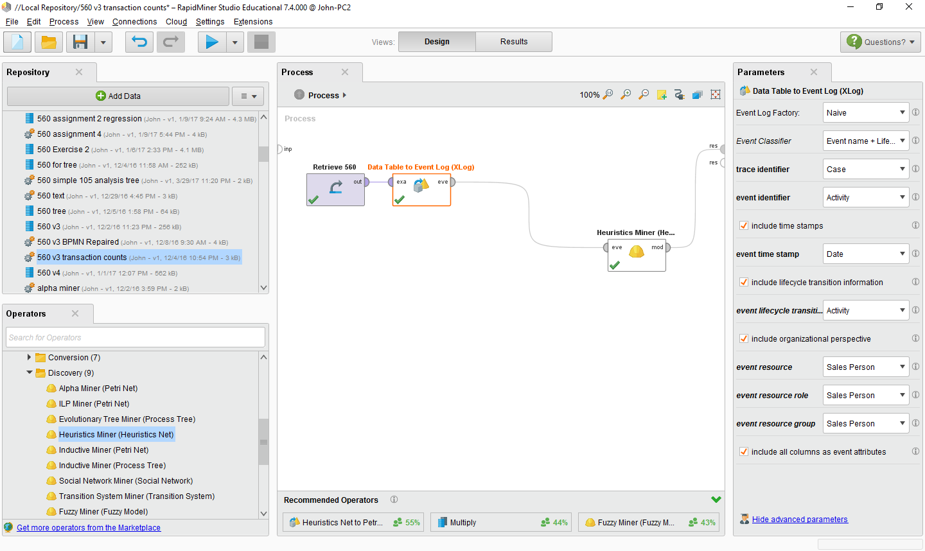

Slide 49
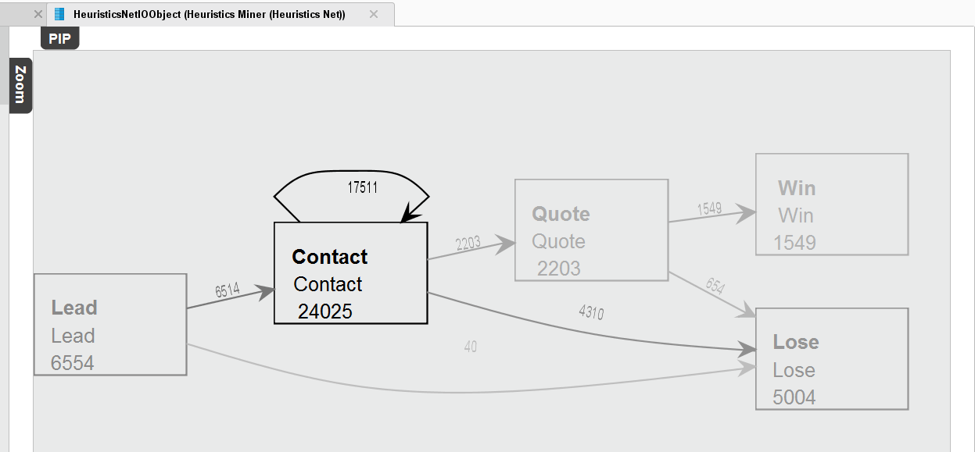

Slide 50
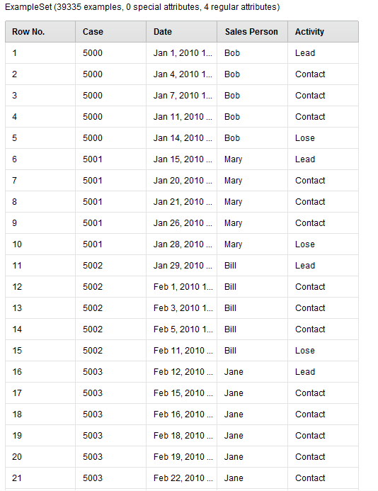

Slide 51
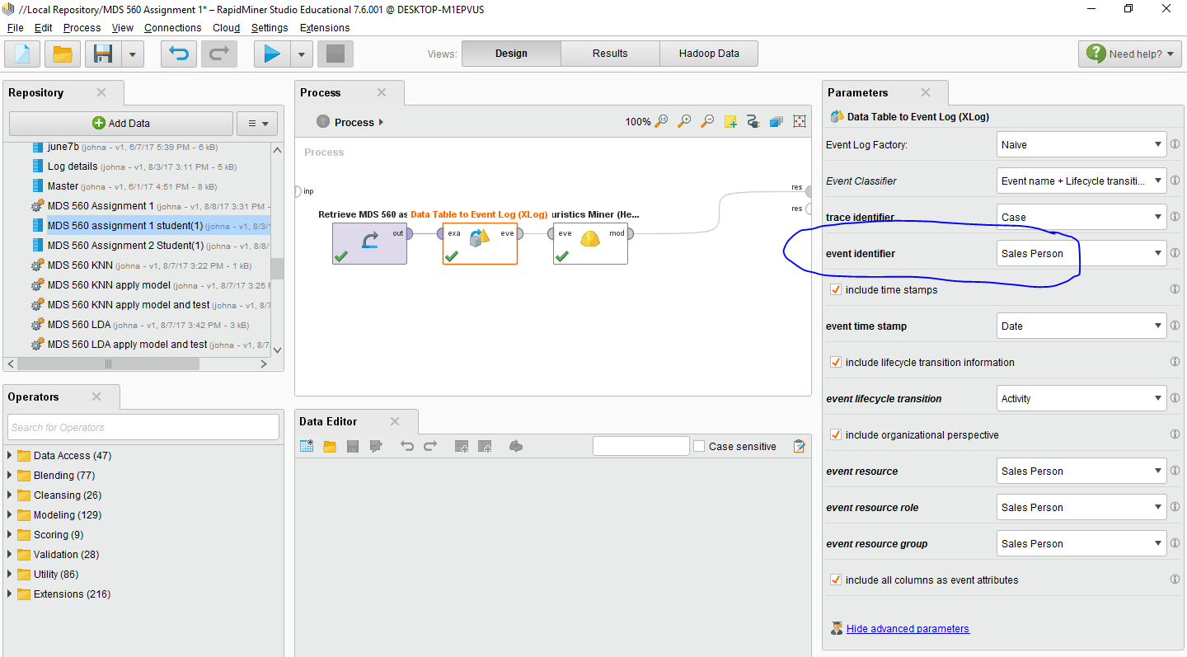

Slide 52
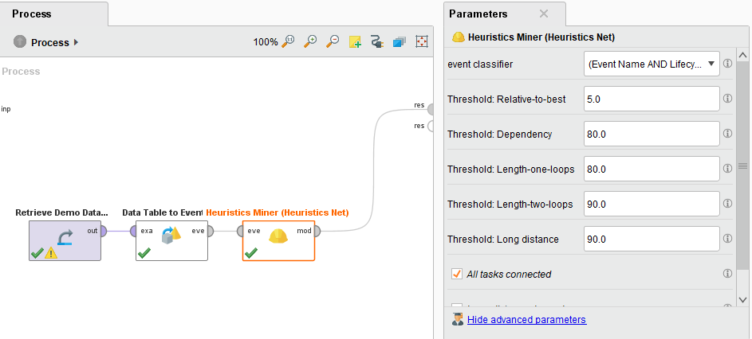
You May Have to Reduce Thresholds

Slide 53
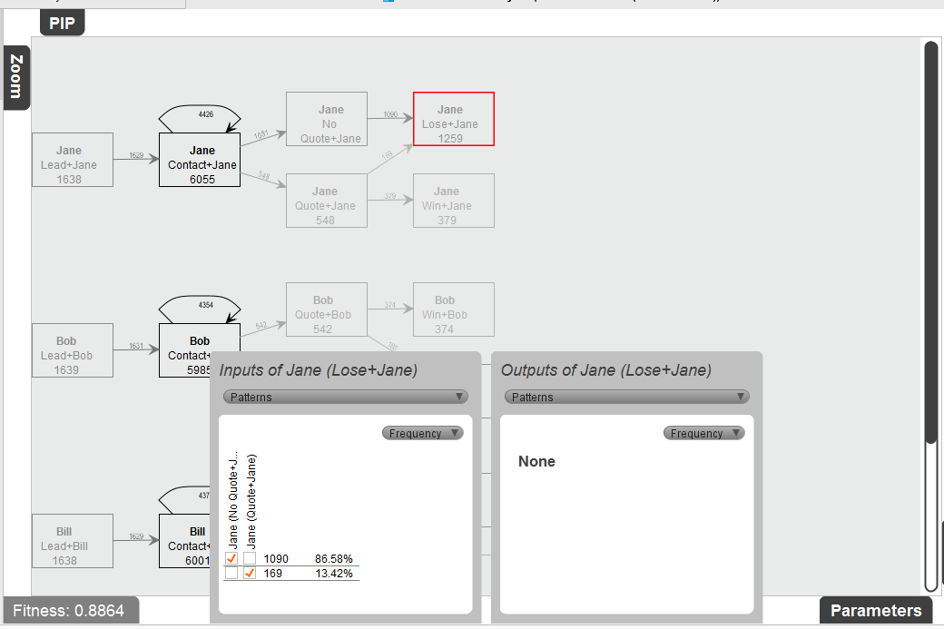

Slide 54
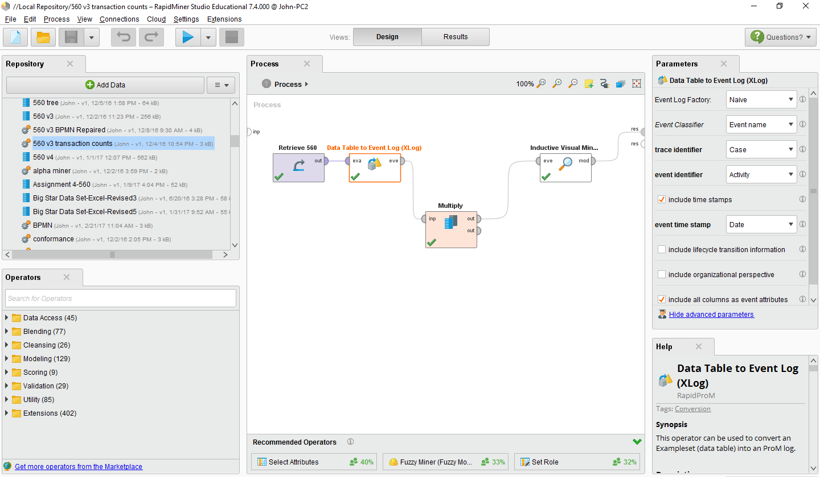

Slide 55
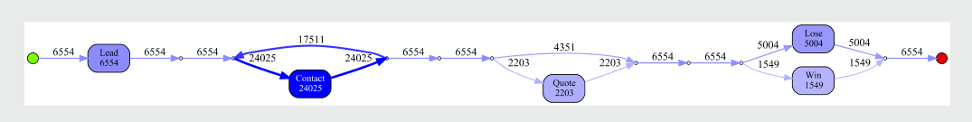
Inductive Visual Miner (Optionally)

Slide 56
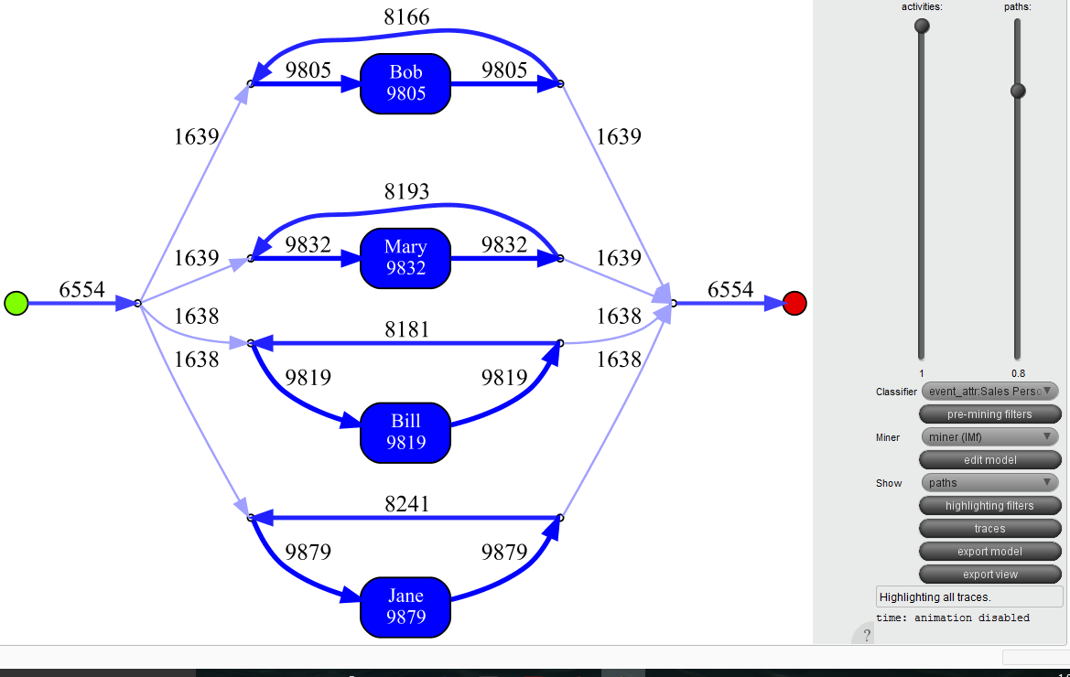
Inductive Miner

Slide 57

Identify and Remove Potential Bottlenecks
Process Mining Using RapidProm

Slide 58
Process Mining Models Can Be Very Helpful For Hypothesis Generation
Process Mining Reveals the Importance of “Counting” Event Frequencies. Event Counts/Total Opportunities Can Be Translated to Probabilities
It Introduces the Pareto Principle (AKA--Modal Saliency (e.g. 80-20 rule)
The Most Important Events Have the Highest Frequencies of Occurrence
We Also Gain Adequate Insight to Formulate Hypotheses Regarding Root Causes of Problems or New Opportunities
Also, Recall Our Discussion About the Principle of Insufficient Reason
But We Are Not Quite Ready To Call the Models “Causal”

Slide 59
We Now Move On to Apply the Scientific Method to Uncover and Resolve Process Problems/Uncover Opportunities
We Will Discuss Prediction: Regression and Classification
We Always Start with Our Methodology
We Don’t Just Begin Modeling
We Follow a More Methodical Approach
We Combine Good Project Management and Good Data Science Practices
Our Goal Is To Explain, Predict and Provide Guidance for Actions That Improve Performance, Create Value and/or Competitive Advantage.

Slide 60
We need to Augment Process Mining with Data Mining to Determine the Root Causes of the Problem Scientifically

Slide 61
The CRISP-DM Project Methodology---The Pursuit of Causation

Slide 62
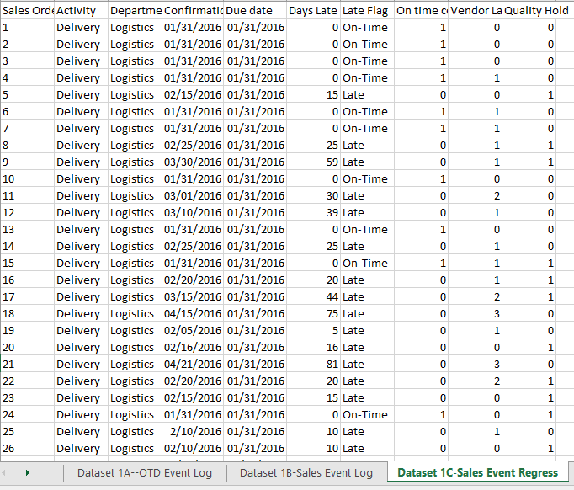
Dataset 1C--Going Back to Our Analysis of the On-Time Delivery Project
PPI, KPI or Balanced Scorecard items to be predicted
Label=Y Variable
Possible Predictors=Features=Attributes=X Variables

Slide 63
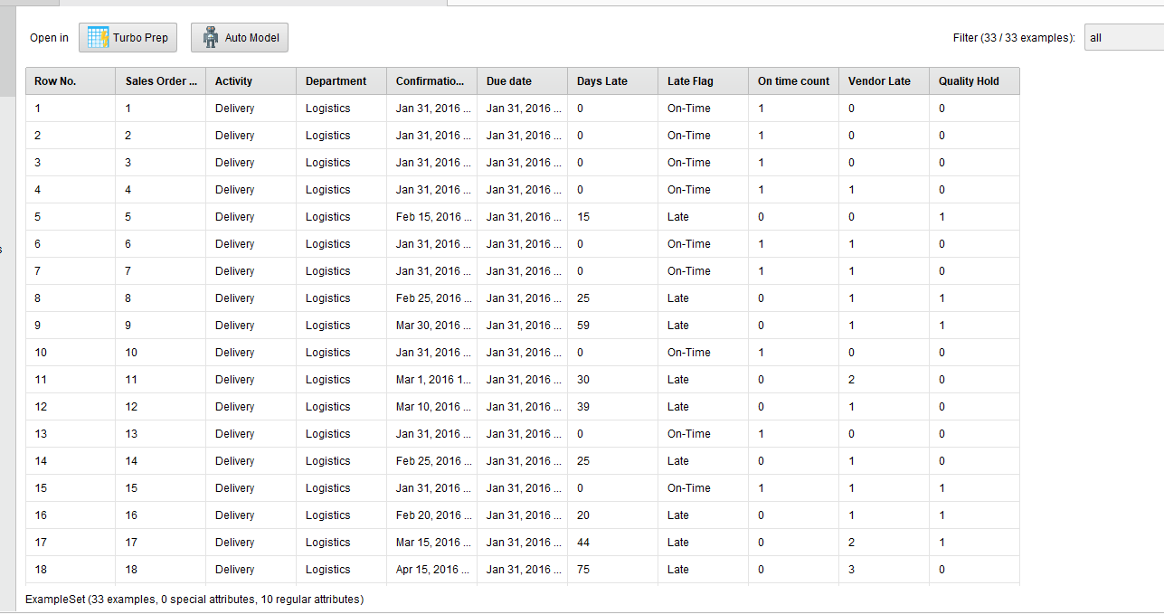
Dataset 1C In Rapidminer

Slide 64
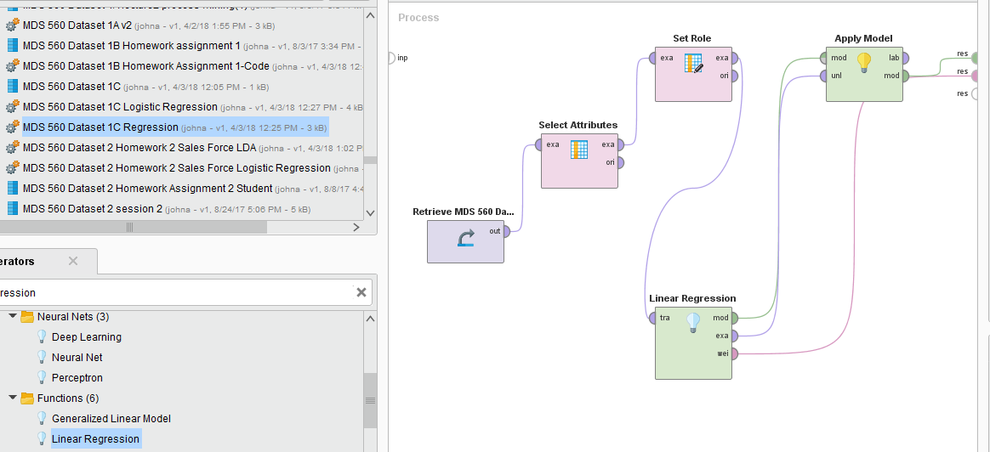
Dataset 1C—Linear Regression with Numeric Y Variable—Number of Days Late

Slide 65
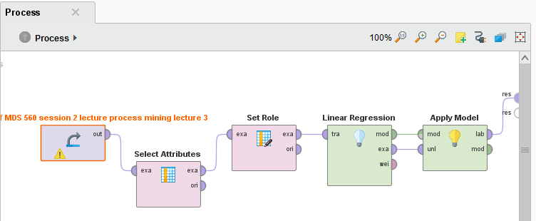

Linear regression on Predicting Days Late-OTD Example

Slide 66


Regression Model
Output =Numeric Values
Property of coefficients=Best Linear Unbiased
Implies a General Additive Model
Assessment=Explanatory Power=R²
RMSE, MSE, MAD
Parametric Model
Days Late for Order
Number of Quality Problems
Number of Vendor Late Problems
Regression coefficients have BLUE properties

Slide 67

This Response Surface Is Tied to a Cost Function

Slide 68



Variable Importance

Slide 69

Linear Regression Analysis in Rapidminer
dY
Interpretation: for every vendor late notification received, we add 16 days being late in shipping the order to the customer.
Guidance toward more specific action
dX_{i}

Slide 70
Peirce’s Trichotomy of the Scientific Method
As Self-Correcting Cycles Leading to the “Truth”
Multiple
Hypotheses
Abductive
Reasoning
Begin Next Cycle with Convergence on “Truth”
What are Testable Conclusions About Other Phenomenon That Must Be Reached For Each Hypothesis if True?
Controlled Experiments Based Upon Samples From a Population
Explanatory
Hypotheses
Experience
Process Definition With “Counts”
What Must
Happen If True?
Deductive
Reasoning
Begin Research
Assess Results of Application and Adjust Hypotheses
A Question
Sufficient Accuracy Reached to Take Action
Elimination
of False Hypotheses
(retroduction)
Test Predictive
Models
Execute Actions
Inductive
Reasoning
Assess Accuracy
reflects imaginative interpretation of results.
Economics Plays a Role in Sufficiency Decision.

Slide 71
A Preview of Phases 2-4

Slide 72


Parametric Methods—You Know the Structure a priori
Non Parametric Methods—Sensitive to the Local Structure of the Data

Slide 73

Regression Versus Classification
Regression Considers Numeric Responses
Classification Considers Counts, Voting, Probabilities and Odds for Categorized Outcomes

Slide 74
Quality Level
Y labels
Linear discriminant Analysis Maximizes Separability of the Classes
X₂
X₂
Linear Discriminant Analysis is a Classic, Classification Algorithm
On Time Orders
Impurity
Late Orders
X₁
X₁
Discriminant Model
Output =Classification into Groups
Assessment=Predictive Accuracy and Precision
Vendor Performance Level

Slide 75
Quality Level
X₂
Y labels
Linear discriminant Analysis Maximizes Separability
X₂
On Time
Late
Vendor Performance Level
Boundary Line
X₁
X₁
Z Vector

Slide 76


Vendor Performance Level
Y labels
Hypothetical Sample of 100 Orders
X₂
On Time
Quality Level
Vendor Perf Level
Late
On Time
Late
A
Quality Level
X₁
B
On Time
Late
Z

Slide 77


We solve for B coefficient values that achieve this

Slide 78

A More Typical Looking Plot in R² Space Using More Data Points
# of Quality Holds
# of Vendor Late Deliveries

Slide 79



Given the class probabilities, the mean vectors and the covariance matrices for each class (late or on time)
We calculate the pooled covariance matrix and Beta coefficients. These are parameters.
Quality
Vendor
This is an example of a Linear Method
And given any new X vector (new observations) enables us to predict the most likely class given these new X observations.

Slide 80


LDA

Slide 81

We add Steps for Data Prep/Pre-Processing

Slide 82

OLS
Probability
X_{i} Variable
Criteria Scores

Slide 83



Probability
Probability

Slide 84


Threshold

Slide 85




Slide 86



An Intuitive Explanation of Binary Logistic Regression
On Time Delivery Example
X=Number of Vendor Late Deliveries
Y=On Time/Late to Our Customers (1=Late, 0= On Time)
Count of Vendor Late Deliveries

Slide 87


Linear Regression is Treated as Numeric Y = Days Late

Slide 88

Example of Logistic Regression Code

Slide 89


Logistic Regression is Treated as Classification Y = Label On Time/Late

Slide 90

Dataset 1b
Note: To help you get through the notation of Hastie’s et al discussion of maximum likelihood, you might look at two additional videos. One covering gradient descent maximum likelihood as applied to linear regression. The other covering logistic regression. Links are below.
Dataset 2
https://www.youtube.com/watch?v=fkS3FkVAPWU
https://www.youtube.com/watch?v=TM1lijyQnaI

Slide 91


Slide 92

Y for Classification
Y For Regression

Slide 93
The CRISP-DM Project Methodology---The Pursuit of Causation

Slide 94
Appendix

Slide 95
Note How The Methods Provide Prediction and Always Optimize Some Function
Regression-→ Y= Predicting a Continuous Variable
LDA → Y= Categorical for Classification
Logistic Regression→ Y= Categorical for Classification

Slide 96

Critical Element of Six Sigma
Y=f(x)
Most methods seek to optimize information gain by minimizing or maximizing some kind of function.
Time Series not included in this framework
We want to use data to explain and predict process performance.
Insights to change performance by changing features.
But we must also worry about types of error:
Bias
Variance
These are a trade-off where underfitting leads to increase in bias and overfitting leads to an increase in variance.

Slide 97

Homework Assignment 2—Dataset 2-Sales Drivers
Sales Force Productivity Example Using CRM Data--Continued
Next, given your training you now look to predictive modeling to provide explanation and prediction. You continue to mine the data and build a dataset that looks as follows:
“Closed Deal” is your Label or Dependent Variable that is to be predicted. This can be run as either a regression or classification model depending upon your choice of dependent variable (label)

Slide 98


Slide 99


Slide 100


Linear Regression using a 0 vs 1 numeric dependent variable

Slide 101


LDA on Sales Force Data

Slide 102


Logistic Regression

Slide 103
This All Ties Back Into Measuring Progress On a Project
Looking at the CRISP-DM project methodology,
-What steps were completed?
-What steps were skipped?
-Would the demo be considered an adequate project performance?
-Successful Deployment and User Adoption is What Provides Impact and Value..Hence Project Management Tools

Slide 104


Most Common Metrics

Slide 105





Big Picture Clarification
Observable
Process
Process Behavior
Efficiency and/or Effectiveness
KPI
Database
Metrics give us insights toward control of the process

Slide 106
Observable
Clustering Helps Identify Relationships of Variables
KPI
Data
Process
Model Selection Strategy
Predefined Structure or let data define structure
The data itself—how the point cloud looks
The performance of the model (ROC, cross validation, hold outs, etc)
VIPs make sense
The Underlying, Unobservable True Statistical Model that Generates the Data
Unobservable

Slide 107


Observable
KPI
Process
Data
Drive organizational changes to optimize objectives
Model Based Upon Optimization Algorithm
Feature Weights
+
The Underlying, Unobservable True Statistical Model that Generates the Data
Unobservable
Model Approximates
Predict/Explain/Test

